Slide 1


ECEN 404
Team 09
Cardioid Fiber:
Michael Jimenez
Ervin Lopez
Aaron Whitehead
Austin Whiteley

Slide 2

Executive summary
Problem statement:
Today heart disease is the leading cause of death in America. Roughly 630,000 Americans die from heart disease every year.
A heart attack is defined as damage to cardiac tissue due to the blocking of coronary arteries.
Our smart shirt will:
Track the user’s heart rate and breathing rate to predict a heart attack
Send out an emergency message to a person specified by the user if a heart attack is detected

Slide 3
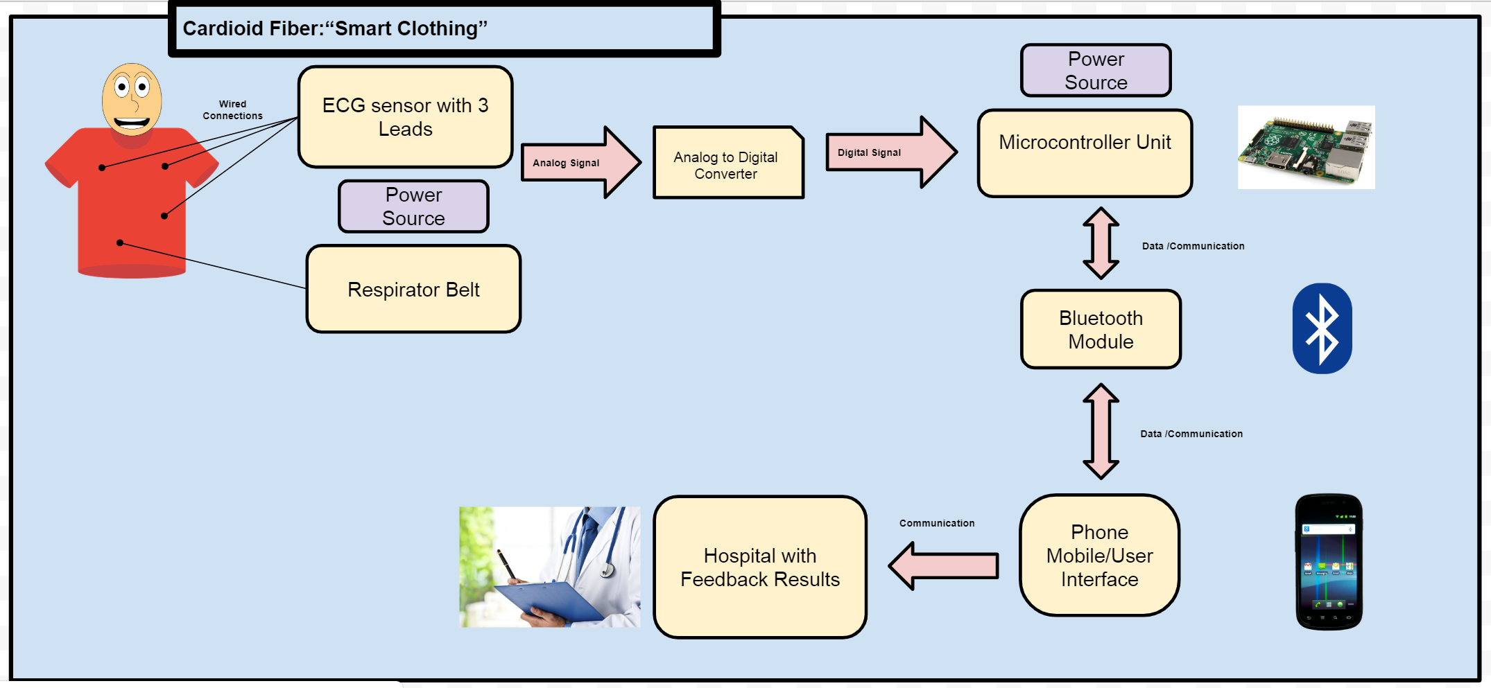
System Overview
Notes:
Cloud server and database

Slide 4
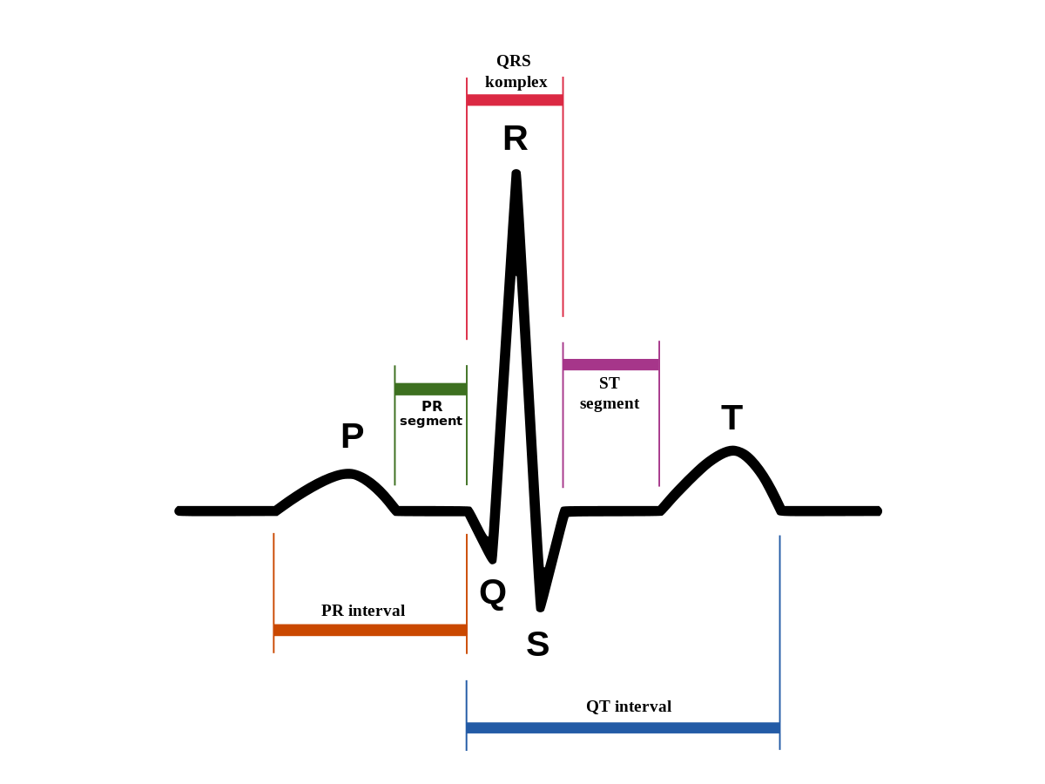
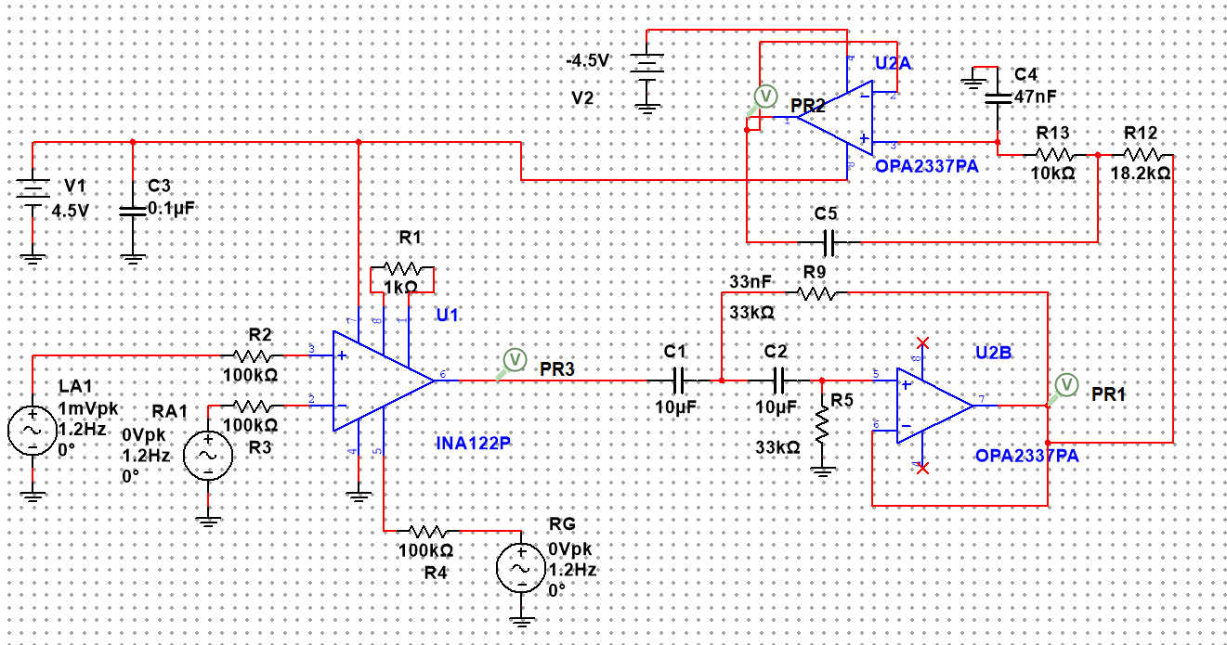
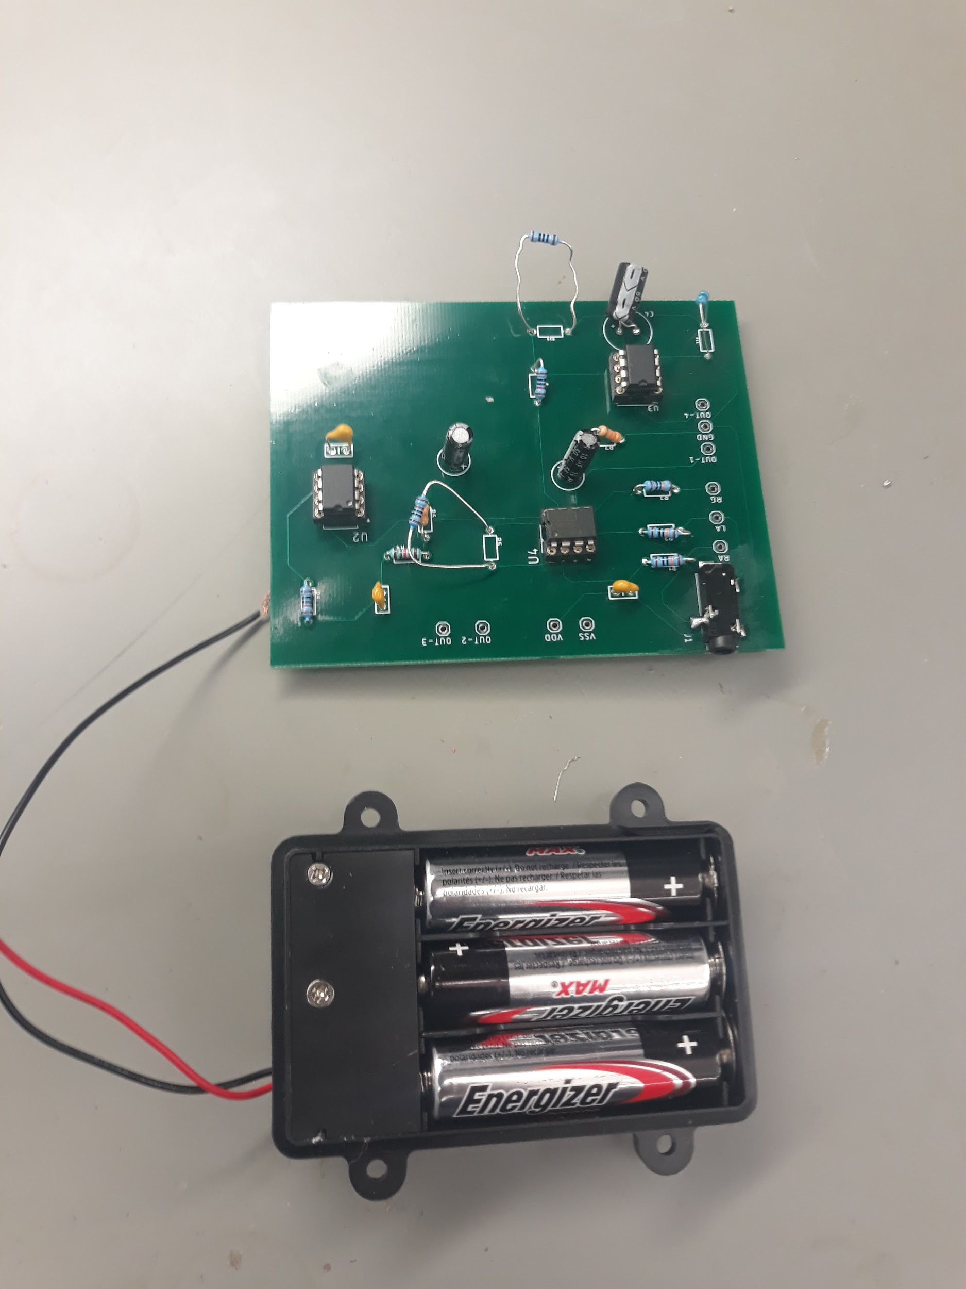
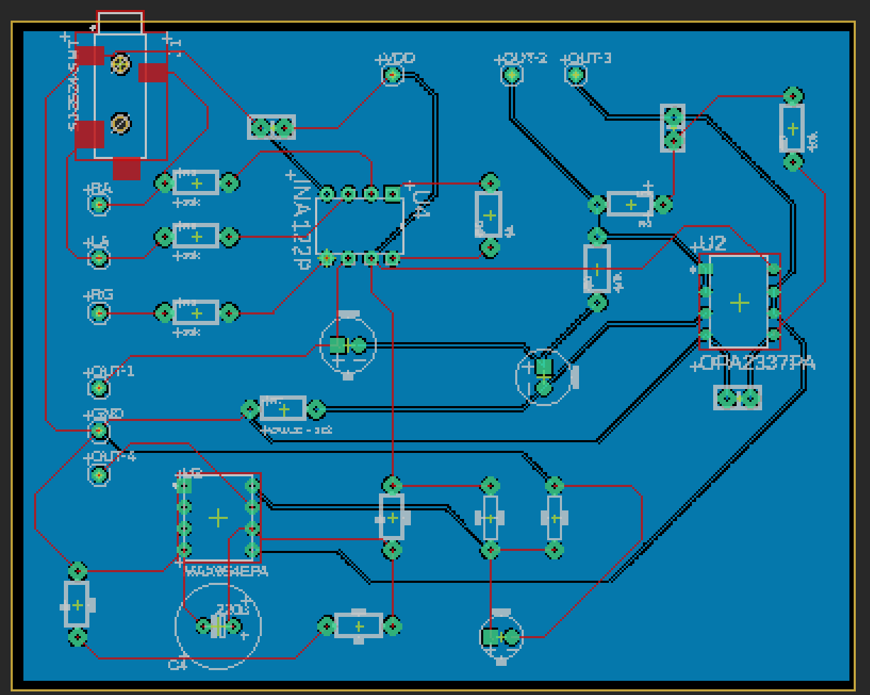
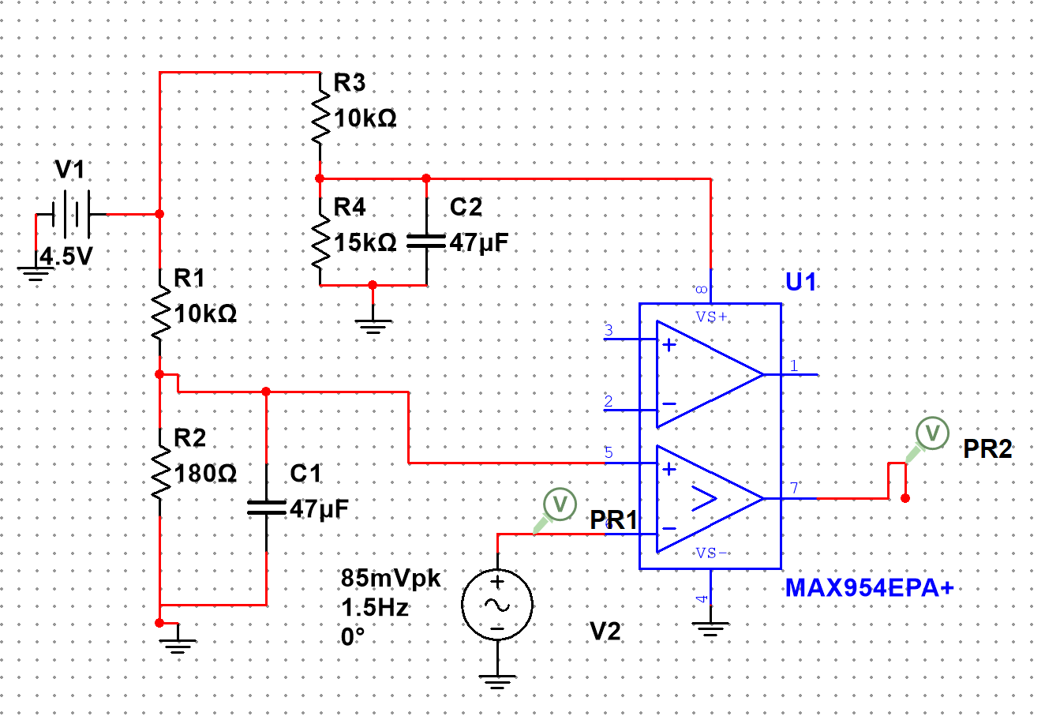
ECG Subsystem Michael Jimenez
Accomplishments since the last presentation 100 hrs | Ongoing progress/problems and plans until the Demo
All subsystems communicate with microcontroller Fixed Comparator to have an output of 2.77 Voltage Setup wiring for clothing design | Sew all subsystems on clothing design (Nov 18) Test clothing design(Nov 18) Complete Video(Nov 20)
Figure 1: ECG (top) and Comparator(bottom) Schematic
Figure 2: PCB Board and Battery
Notes:
‹#›

Slide 5
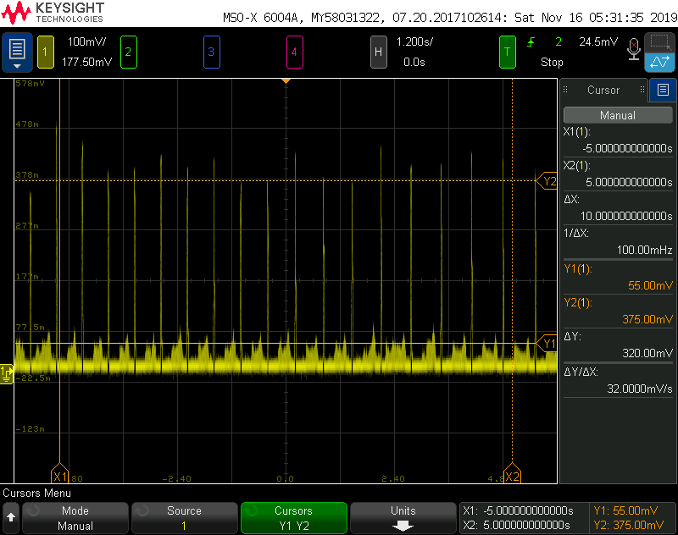
Figure 2:. ECG Signal

Slide 6
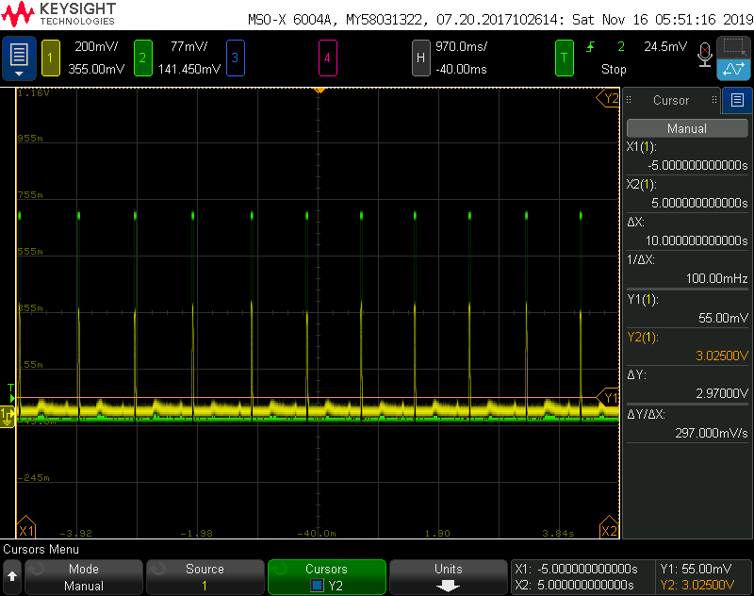
Figure 1: ECG Signal and Comparator Voltage Signal

Slide 7
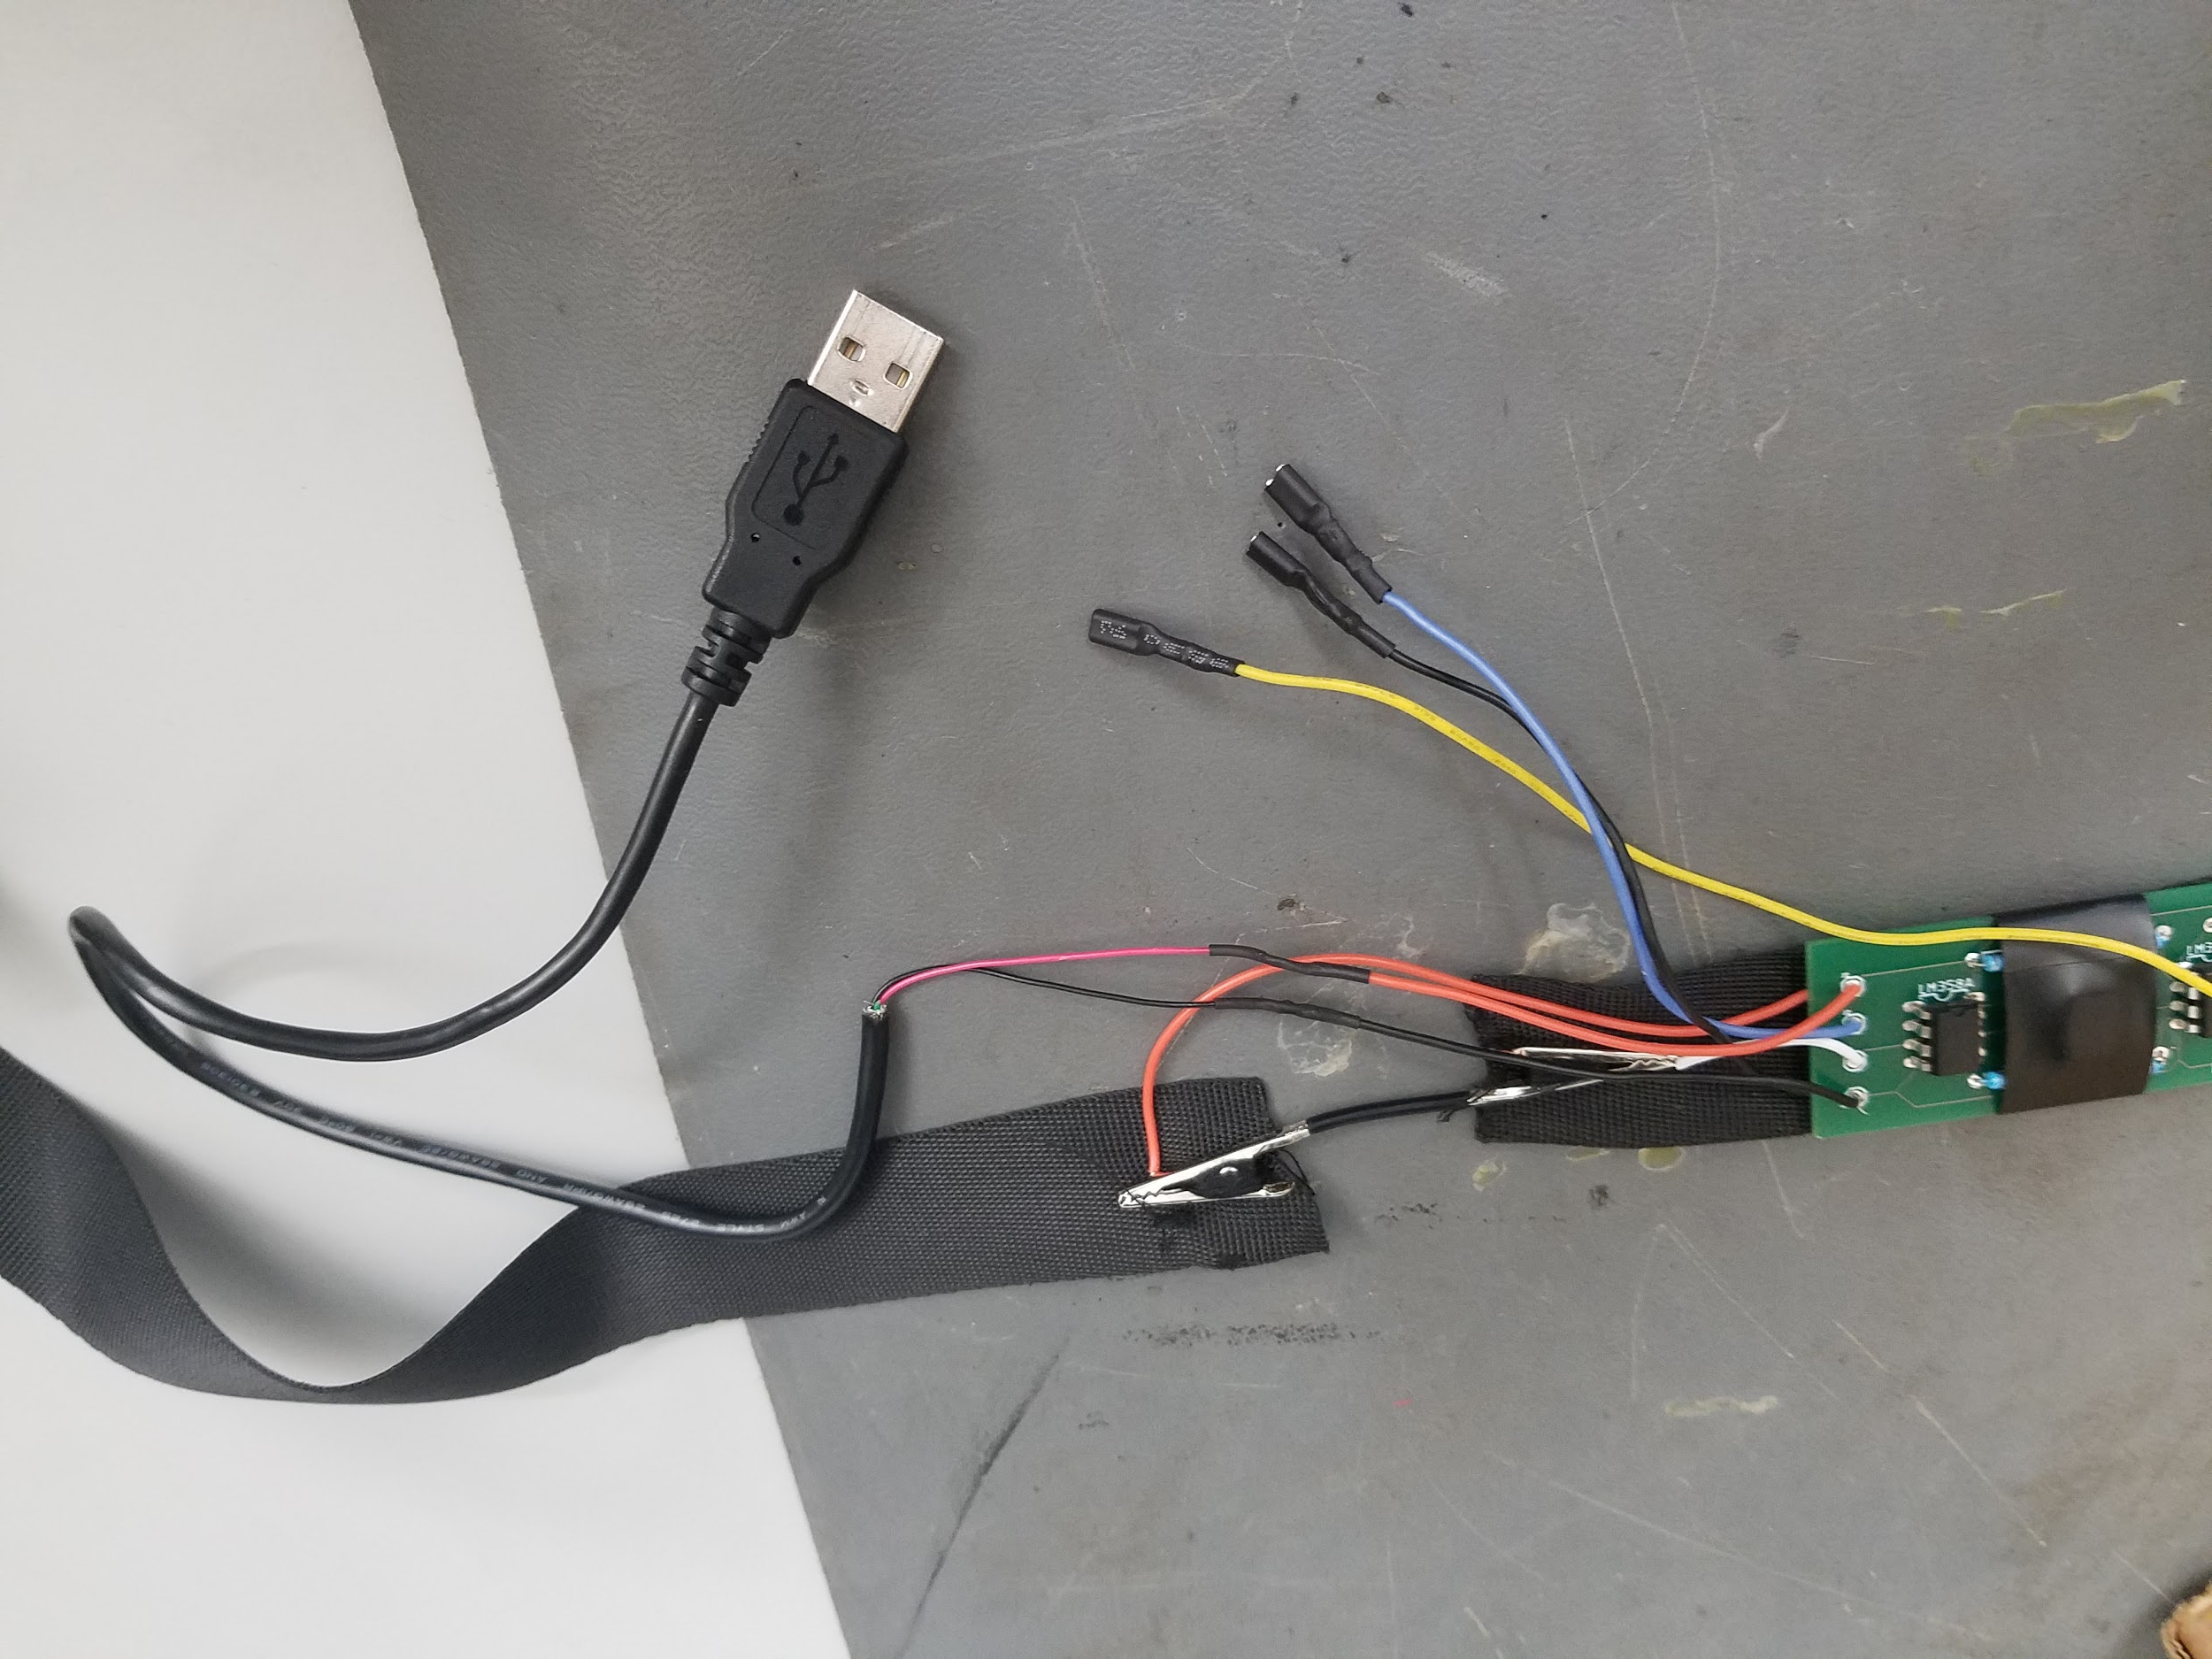
Breathing Sensor Austin Whiteley
Accomplishments since the last presentation 20 hrs | Ongoing progress/problems and plans until the next presentation
add final wires and connections for plug and play added shirt pockets for boards and batteries full integration with ecg and microcontroller running simultaneously | run full system on shirt
Notes:
‹#›

Slide 8
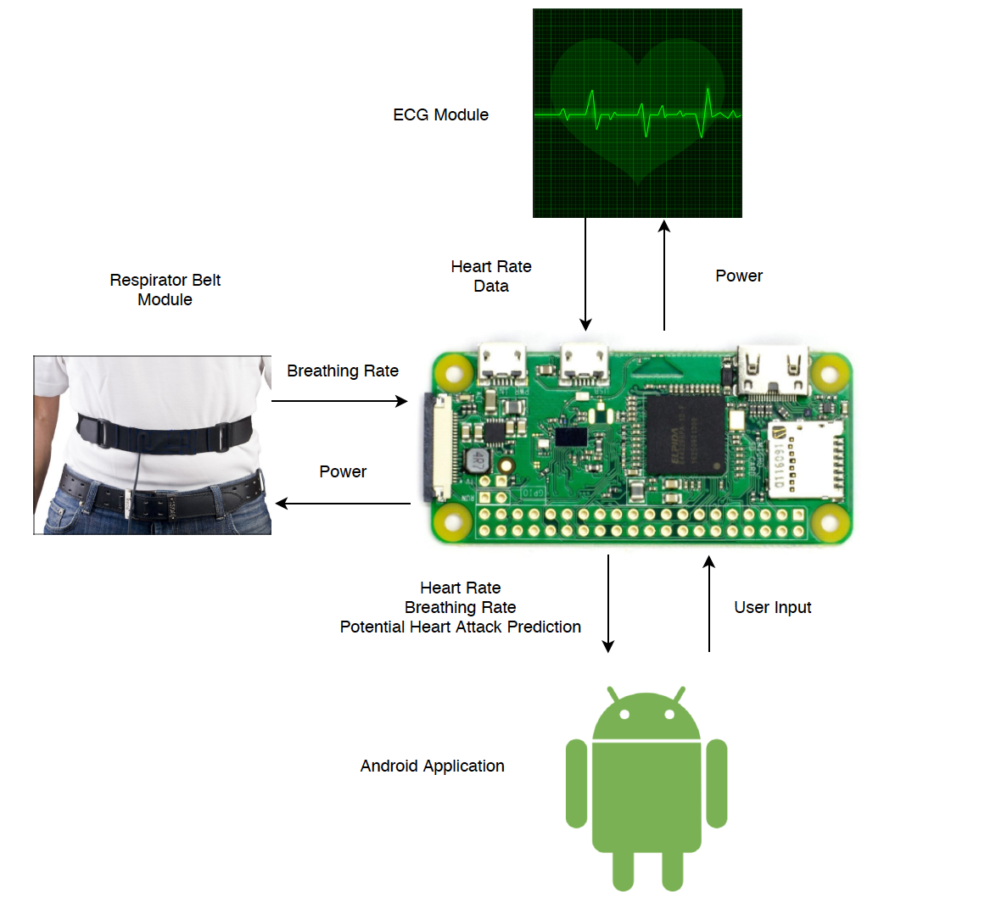
Microcontroller and Power Ervin Lopez
Accomplishments Since Last Presentation 20 hrs
Fully implemented data transfer from the ECG module to the microcontroller using the 16-bit ADC (Had to greatly increase sampling rate to fix this) Fully integrated and validated both hardware connections Fully integrated and validated software connection
Ongoing Progress and Final Plans
Build the shirt with all the HW attached Finish the Final Report
Notes:
‹#›

Slide 9
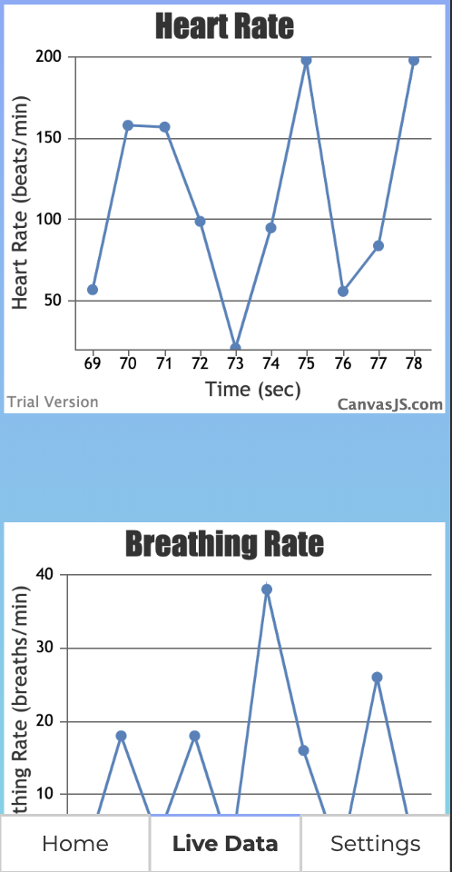
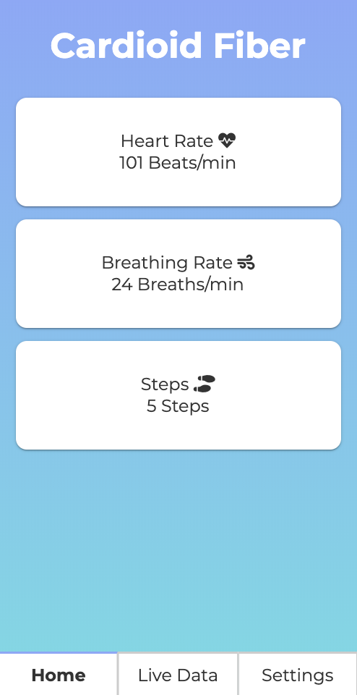
Application System Aaron Whitehead
Cross-platform application that accepts data transmitted by the Pi.
Built in Apache Cordova to allow cross-platform functionality and utility that comes with JavaScript.
Updates data in real time.
Alerts the user if the Raspberry Pi detects an abnormality.
If the alert is not dismissed, a text is sent to the emergency contact.
Notes:
‹#›

Slide 10
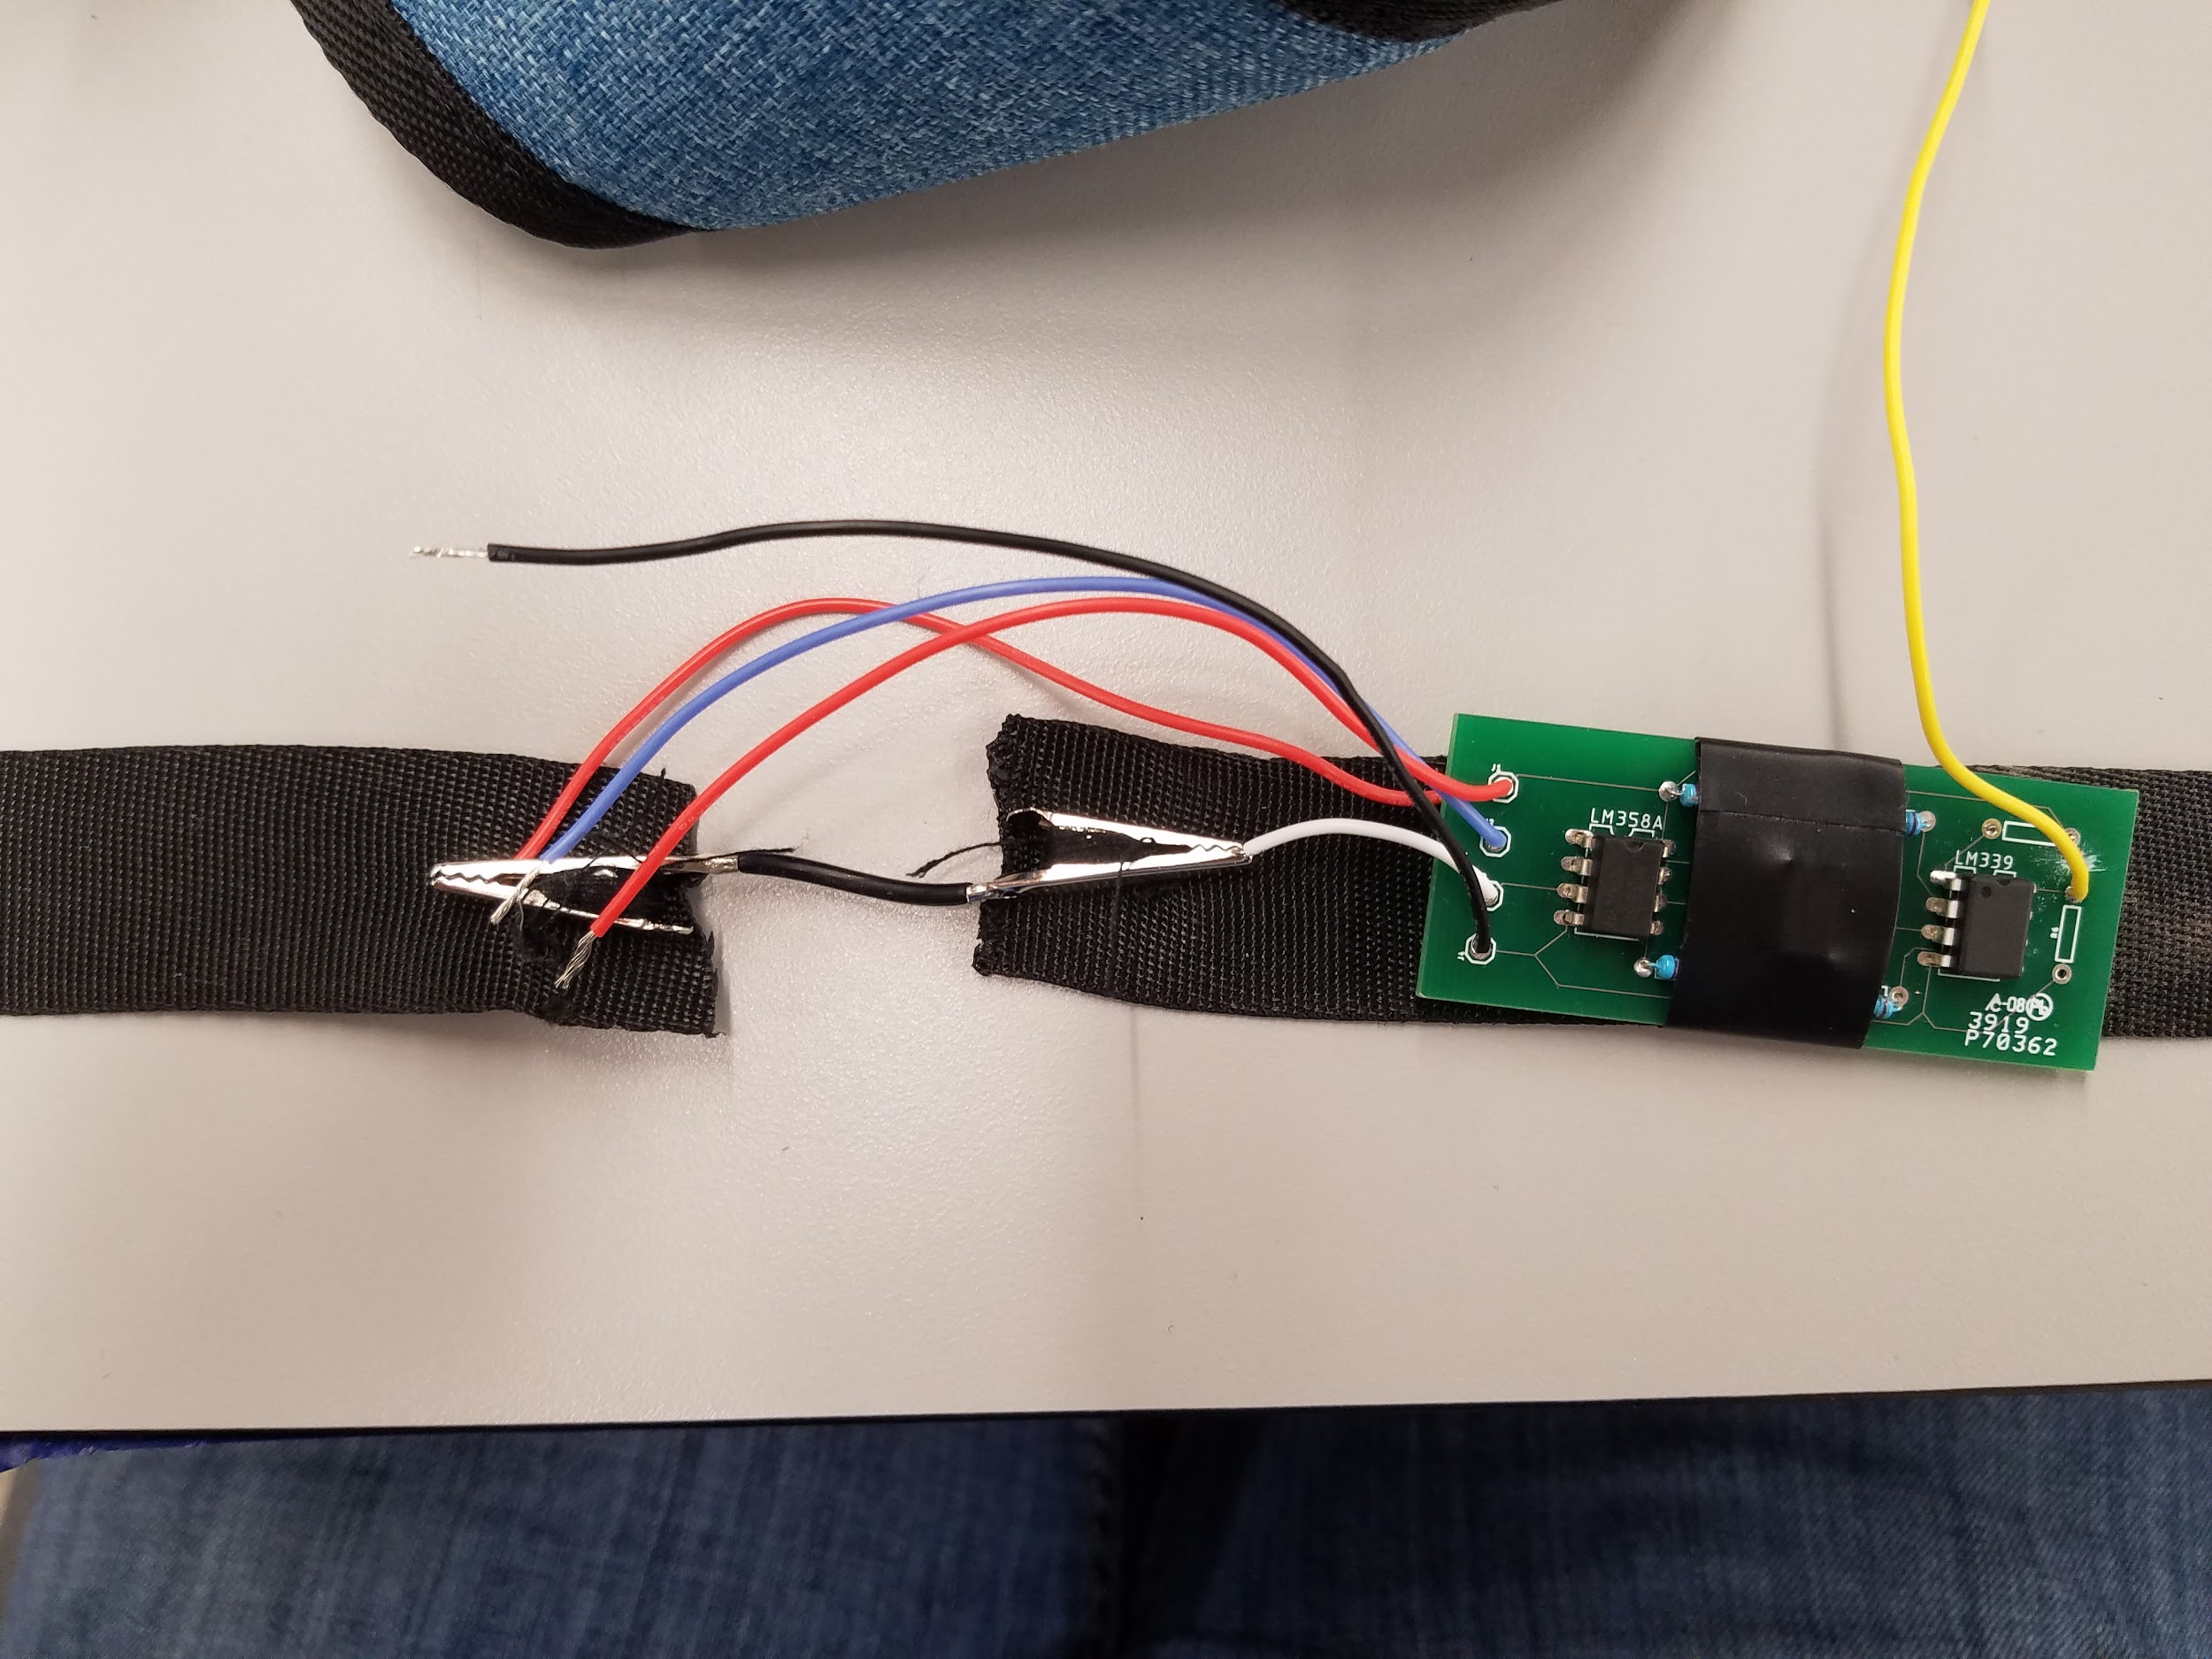
Integration All Subsystems
Accomplishments since the last presentation | Ongoing progress/problems and plans until the next presentation
All subsystems communicate with microcontroller | Sew all subsystems on clothing design (Nov 18) Test clothing design(Nov 18) Complete Video(Nov 20)
FIG 1:ECG subsystem
Fig 2: Respirator Subsystem
Notes:
‹#›

Slide 11
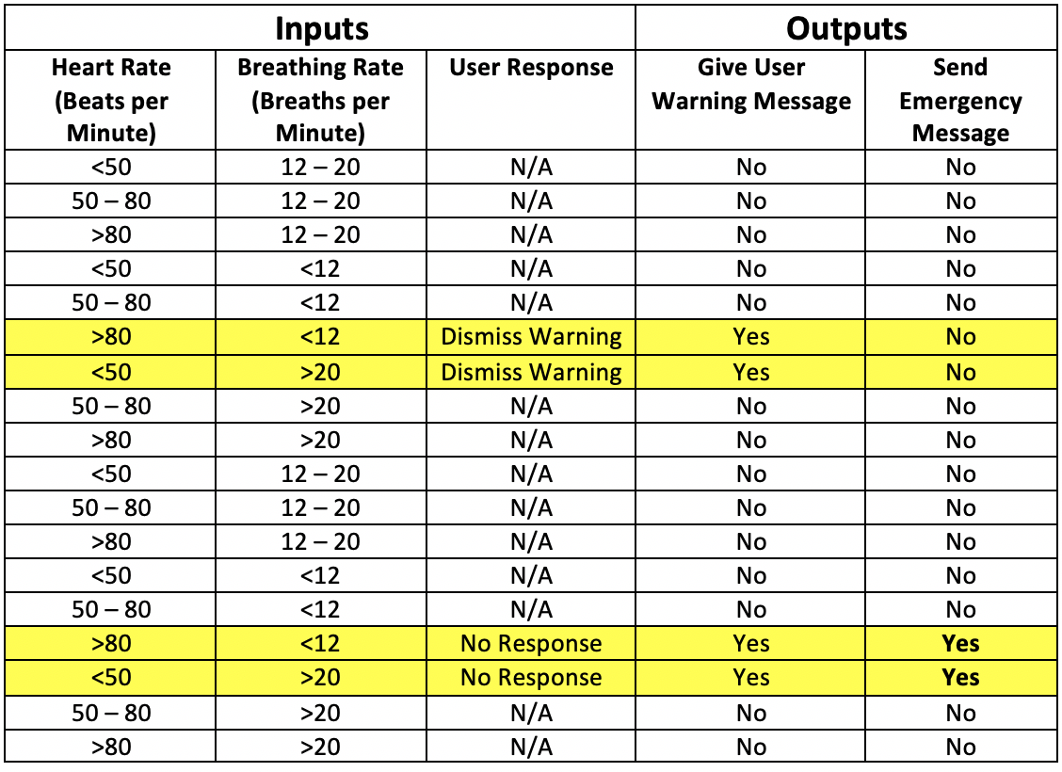
Validation

Slide 12
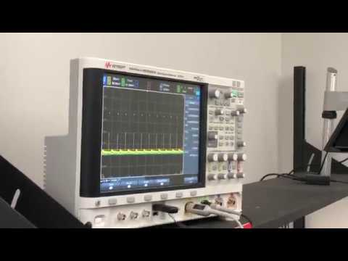
Demonstration Smart Clothing
Notes:
‹#›

Slide 13
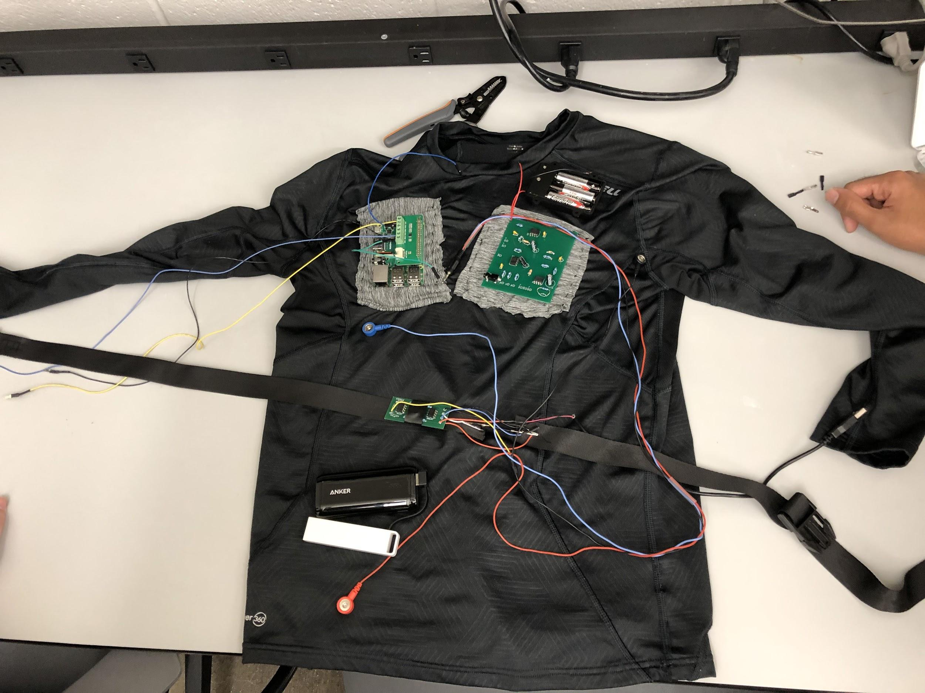
Final Shirt Aaron Whitehead
Notes:
‹#›

Slide 14
Execution Plan
 | 9/9/19 | 9/16/19 | 9/23/19 | 10/28/19
Electrocardiogram | PCB Ordered & Parts Ordered (delayed-completed on OCT. 14)) | ECG subsystem complete and ready for integration (delayed-completed on Oct 19) | ECG connects to microcontroller (delayed-Started On Oct 19) | Other Subsystems communicate with microcontroller
Respiration Belt Sensor | Validate that averaging breathing rate is acceptable | New PCB Ordered
Microcontroller | Heart and breathing rate properly being read with waveform generator | Bluetooth connection with mobile app | Connection to ECG module for heart rate. Integration with application complete | Connection to respirator belt sensor for breathing rate
Application | Front End rebuilt using Cordova & Ionic frameworks | Backend architecture completed. Updated specs | Application connectivity with MCU (send/receive data) | Full integration with system complete

Slide 15
Execution Plan
 | 11/18/19 | 11/18/19 | 11/18/2019 | 11/18/2019 | 11/21/2019
Electrocardiogram | ECG integrated with clothing apparel and begin test analysis | ECG Data Collection & Analyzation with other systems | Evaluate design and other ambiguities | Ongoing analysis if needed and completing the whole system | Complete
Respiration Belt Sensor | Test PCB & integrate with microcontroller | Finish sewing support for microcontroller Make belt pretty | Finish sewing supports for power supply in suit | Sew pockets for ECG System
Microcontroller | Validate connections to both hardware modules | Validate entire subsystem with all 3 external connections
Application | Assist with final shirt creation | Assist with final shirt creation | Finish final shirt | Last minute testing and bug fixes

